Slide 1
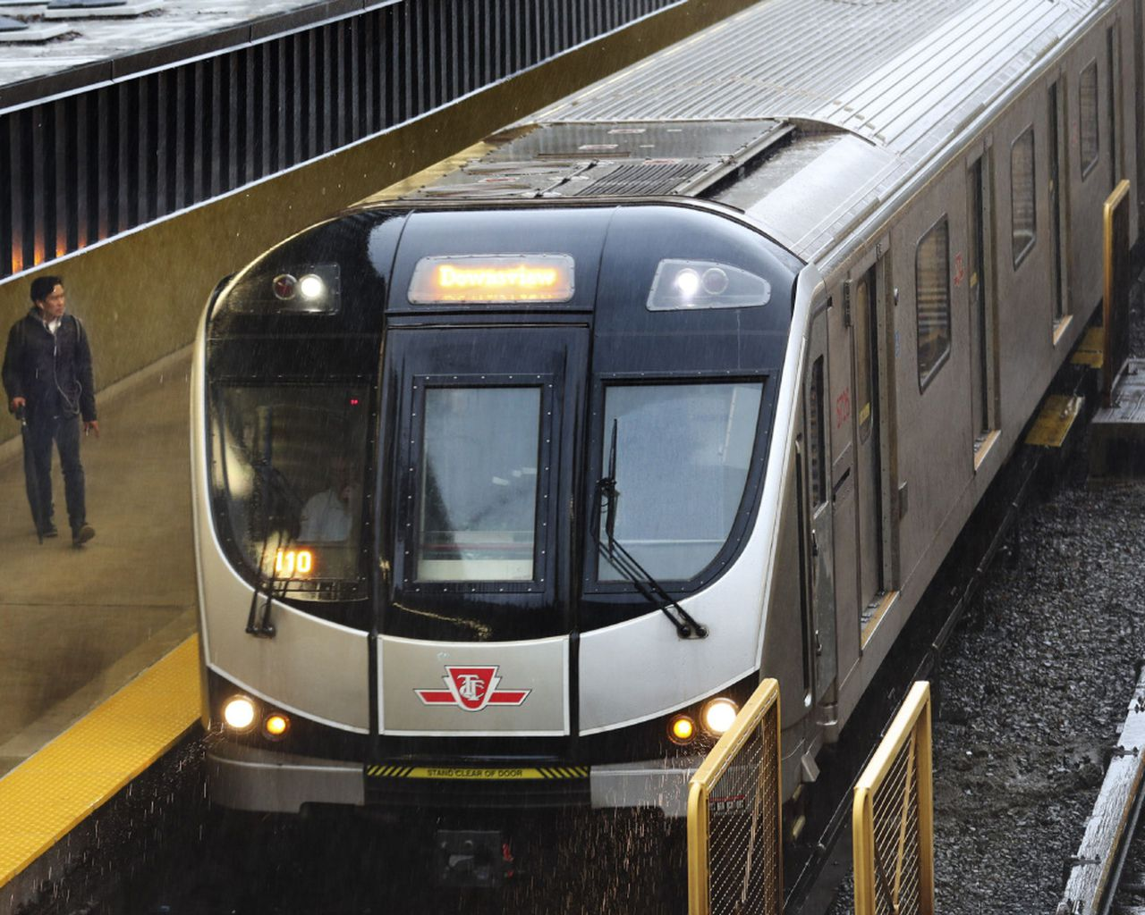
TTC Delay Data
Harsh Gupta, Jonie Caisip, Leandra Lai, Naman Sharma, Ziyad El Amrani-Joutey

Slide 2
Table of Content
Introduction
Data Presentation
Data Cleaning
Preprocessing
Feature Selection
Train Test Split
Model Selection
Prediction
Result Visualization
Conclusion

Slide 3
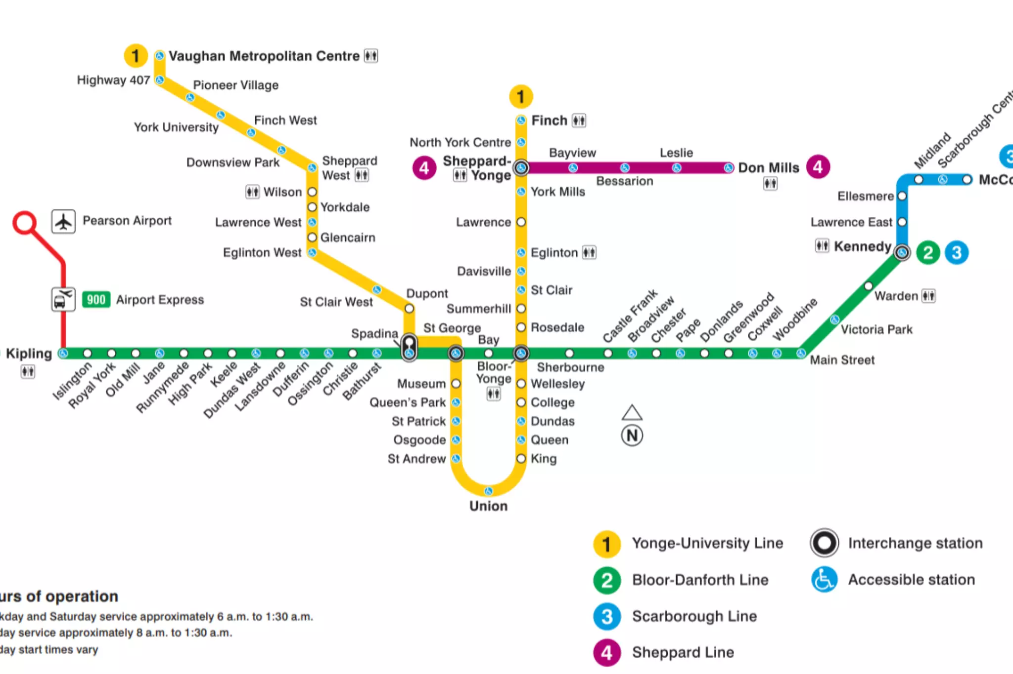
Introduction

Slide 4

Problem Statement
Occasional delays in the TTC subway trains can be a big problem for commuters who have tight schedules and who needs to plan around delay times.
We set out to predict how many minutes will the subway train be delayed in the given circumstances using regression

Slide 5
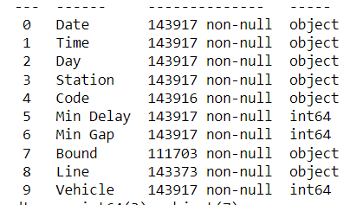
Data Set
Jan 2014 - June 2021
143140 samples/rows
10 columns/features
Categorical features: 7
Integral features: 3
Prediction : Min Delay

Slide 6
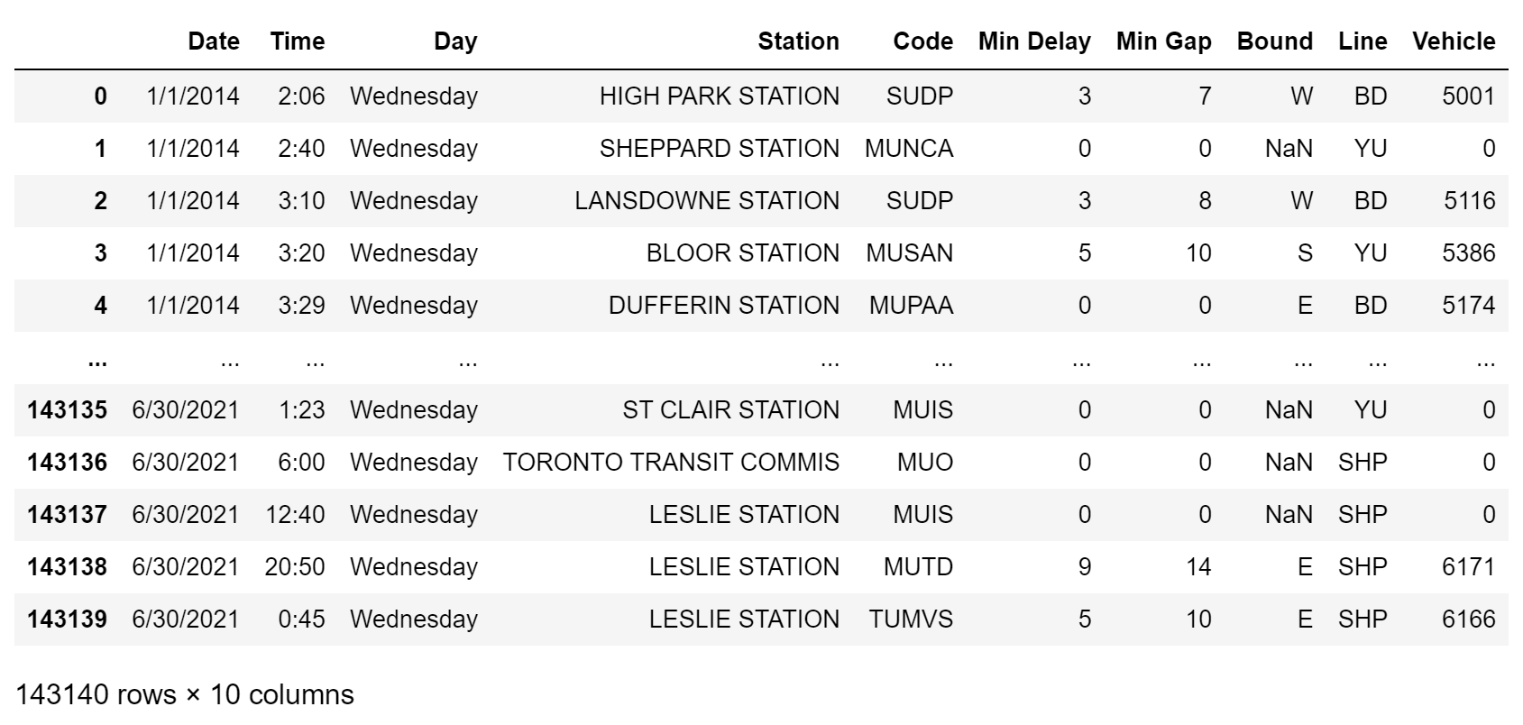

Slide 7
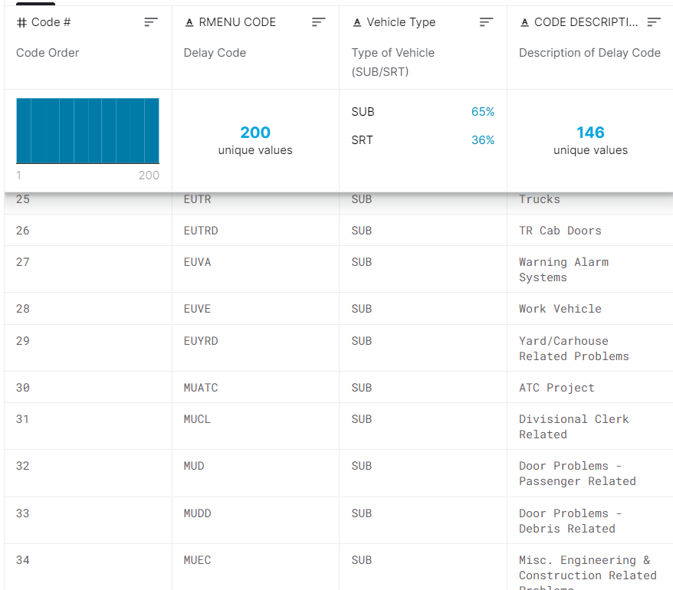
What does the codes refer to?

Slide 8
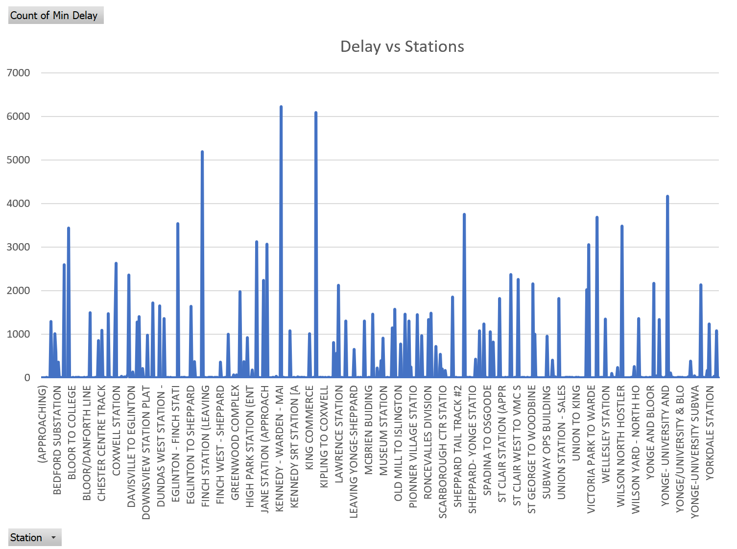
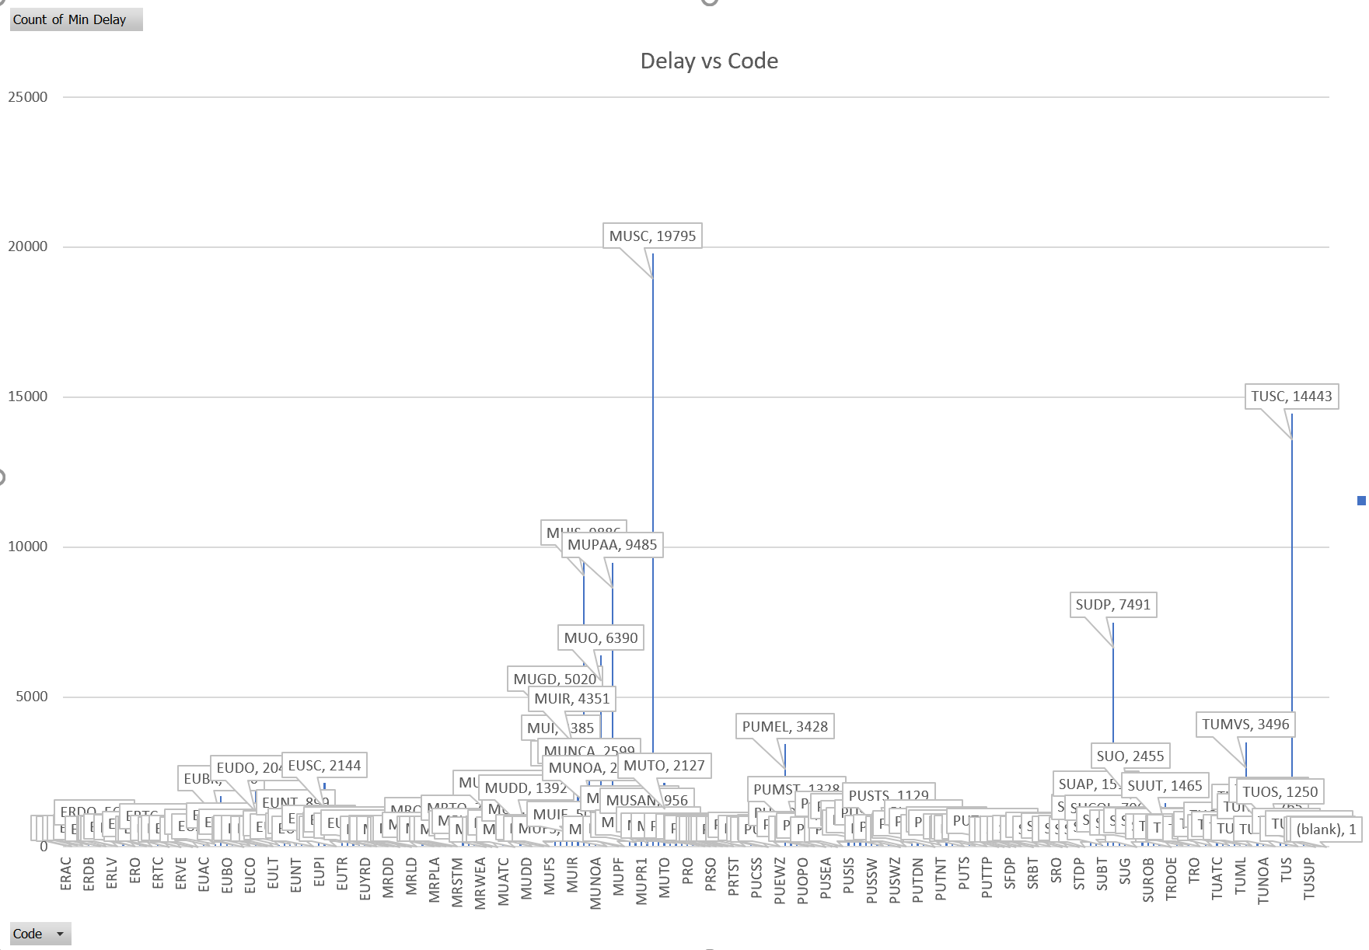
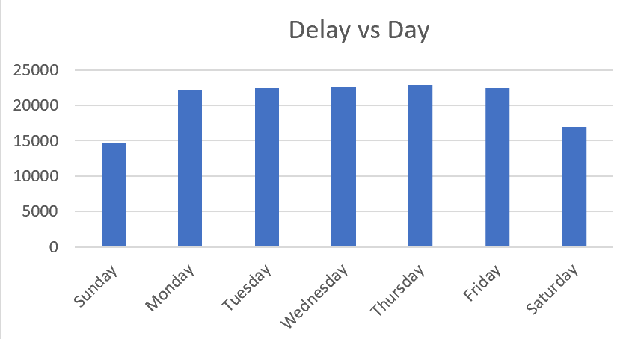

Slide 9
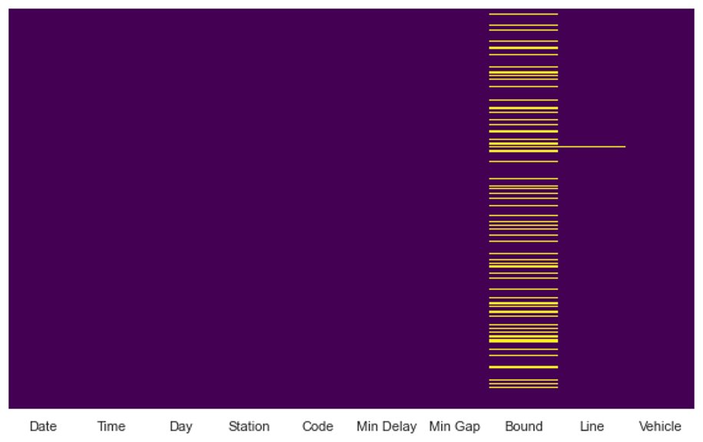
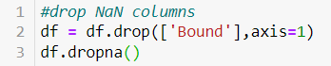
Data Cleaning
Removed
Outliers (extreme values)
Bound column (NaN values 22.5%)
NA/missing values

Slide 10
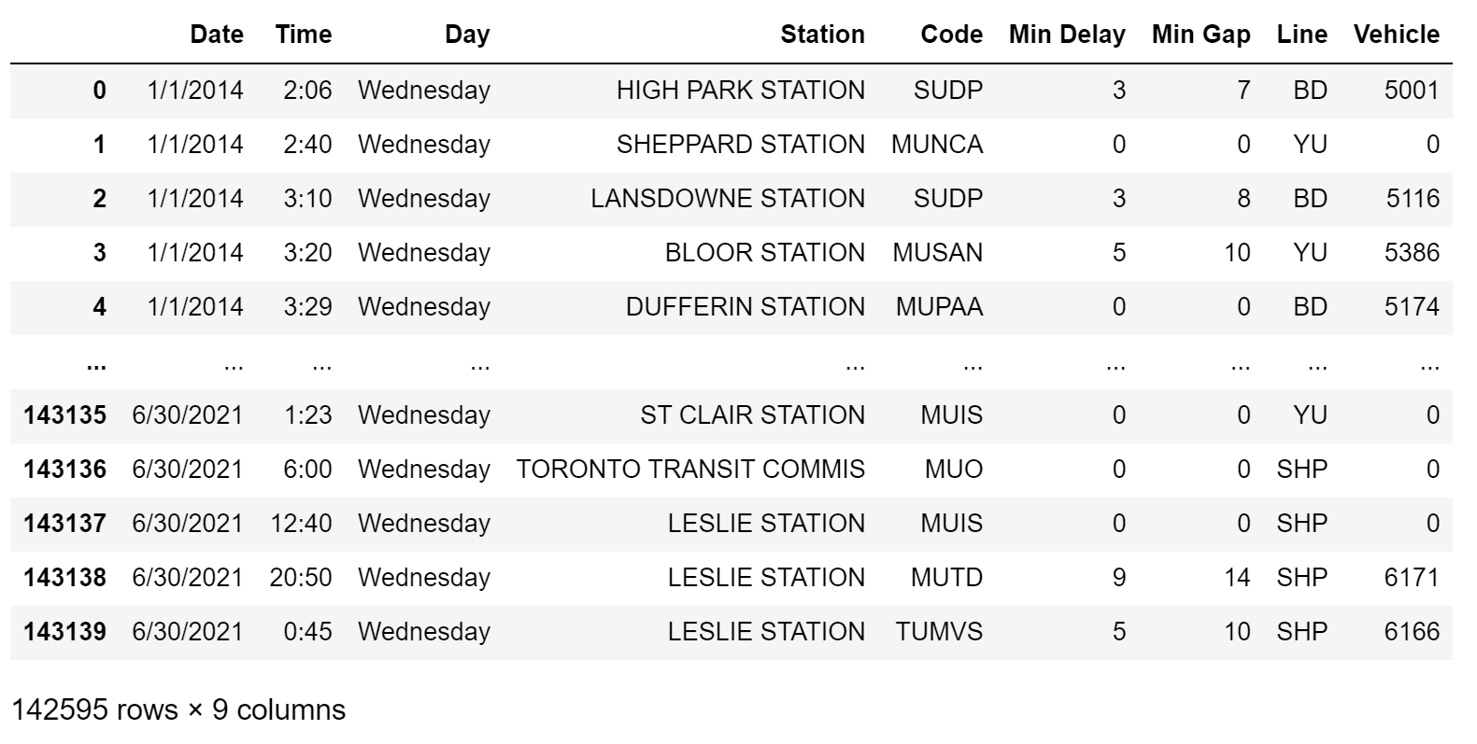

Slide 11
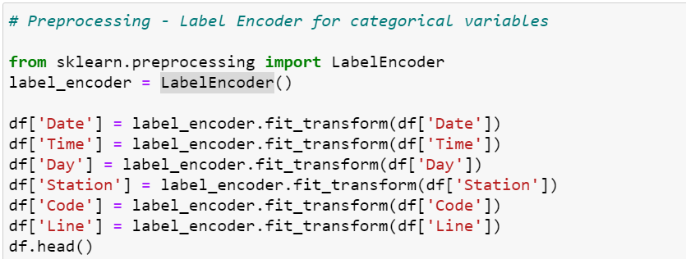
Pre-Processing
What we did?
Notes:
each label is assigned a unique integer based on alphabetical ordering

Slide 12
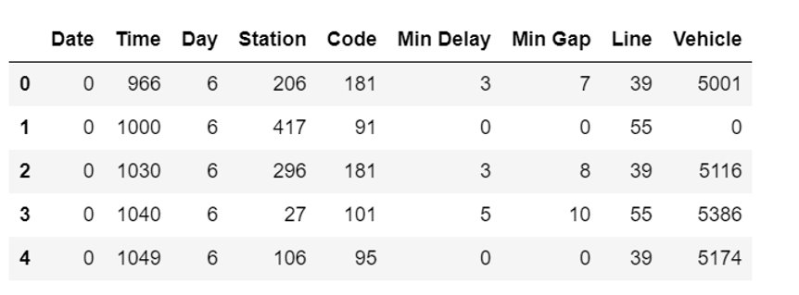
Why Label Encoder?
7 categorical features
Thousands of different values
Unnecessary columns?
Worked well with Label Encoder
Notes:
7 categorical features
Each having more than 40 -50 different values
Why not One-Hot Encoder? adding unnecessary 200-300 columns wouldn't have made any sense
Our Classification worked well with Label Encoder

Slide 13

Feature Selection

Slide 14
All Feature Selection Models
Chi-Squared
RFE
Embedded RandomForestClassifier
Pearson Correlation
Chi-sqaure

Slide 15
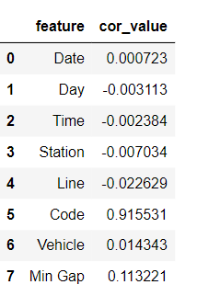
Pearson Correlation

Slide 16
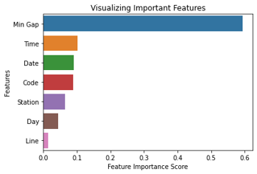
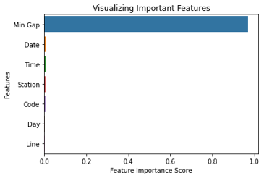
Random Forest Classifier
Random Forest Regressor

Slide 17
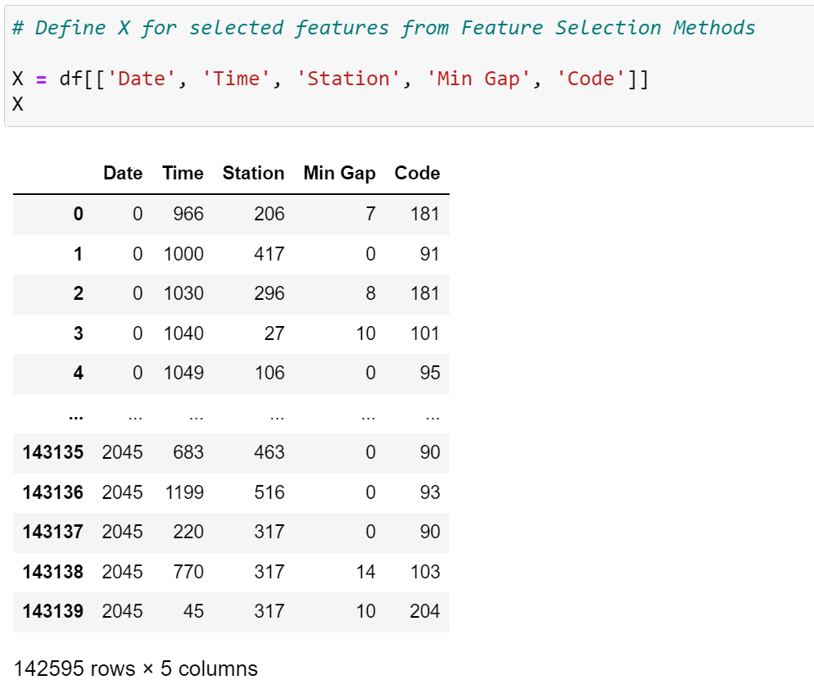
Selected Features

Slide 18
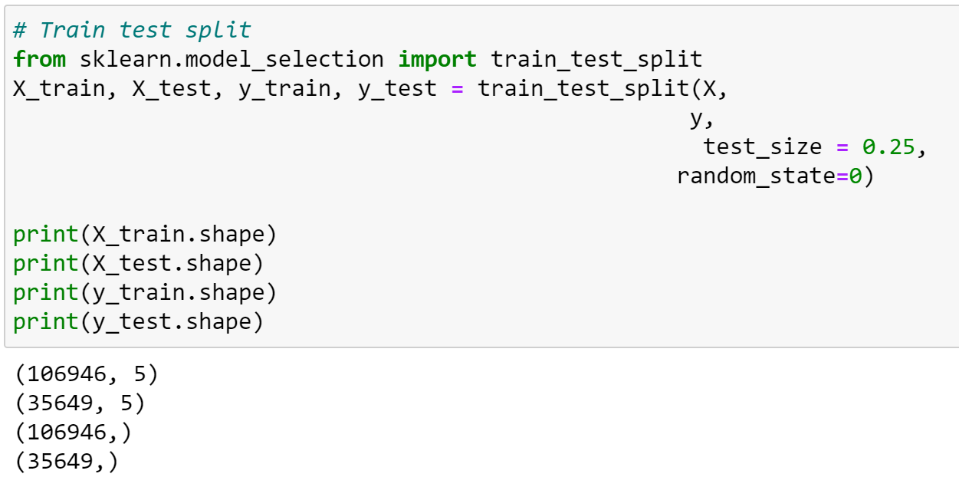
Model Used
Train and Test Data
Linear Regression
Decision Tree Regressor
Random Forest Regressor

Slide 19
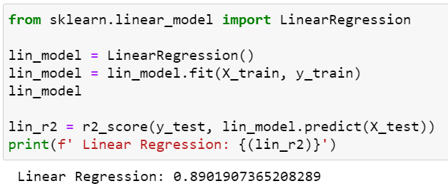
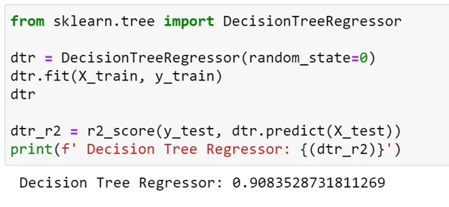
Linear Regression
Test Accuracy: 89.02%
Decision Tree Regressor
Test Accuracy: 90.84%

Slide 20

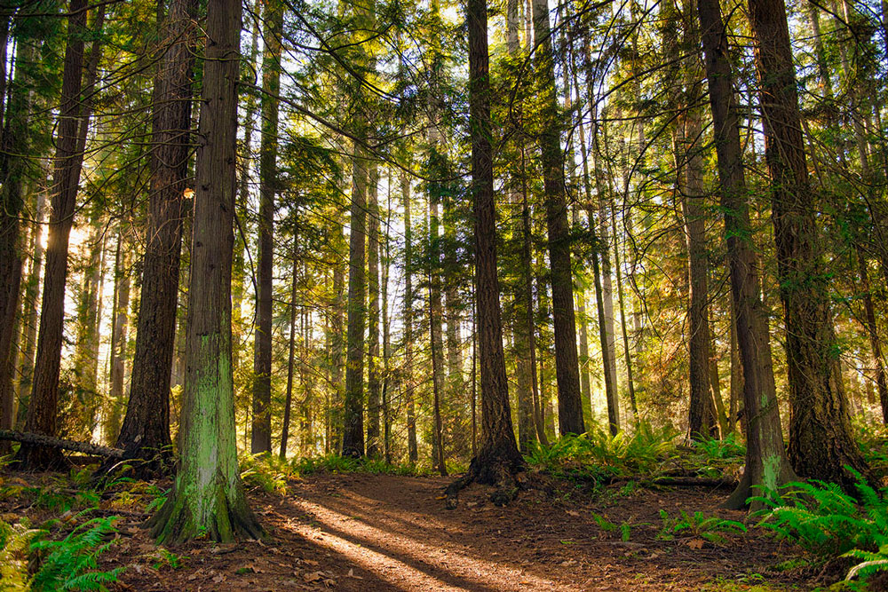
Random Forest Regression

Slide 21
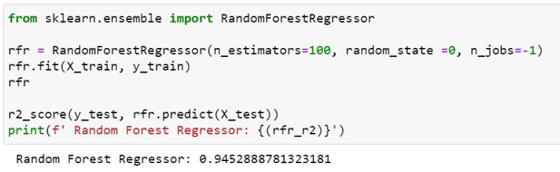
Random Forest Regressor
- 25% test size
- 100 n_estimators
Test Accuracy: 94.53%

Slide 22
Random Forest Classifier ( 2 Classes)

Slide 23
Classification of Minute Delay
MIN DELAY > 0 = TRUE
MIN DELAY = 0 = FALSE

Slide 24
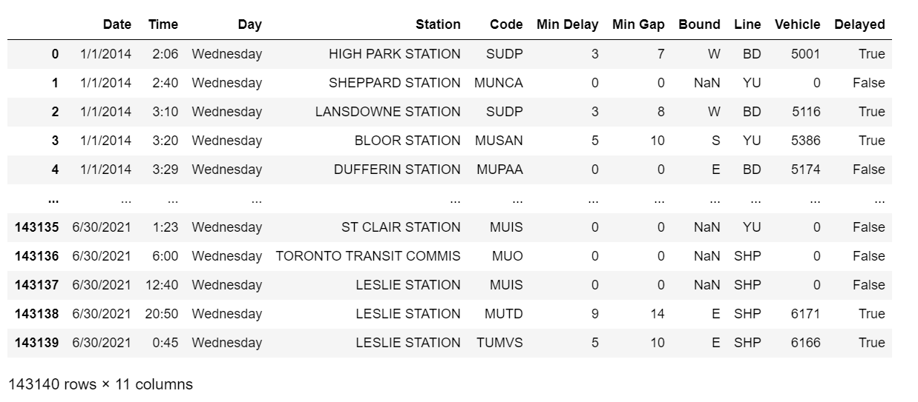

Slide 25
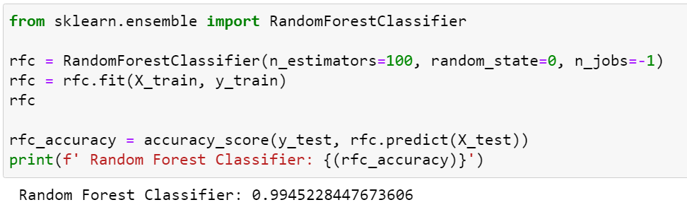

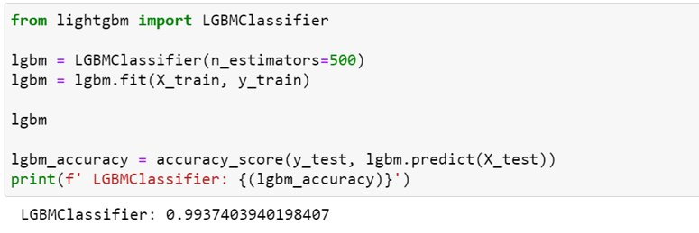
Random Forest Classifier Test Accuracy = 99.45%

Slide 26
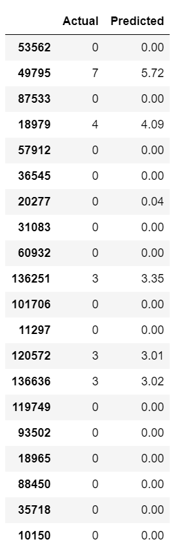
Results
Highest Accuracy (Random Forest Regressor): 94.53%

Slide 27
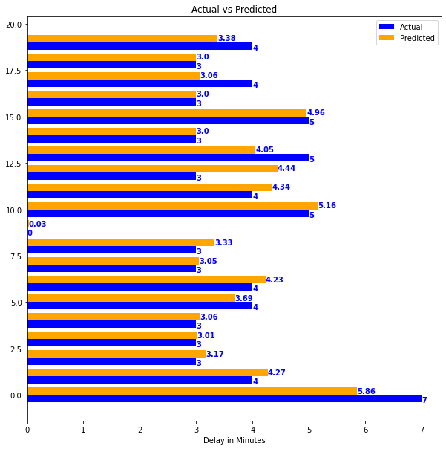
Actual vs Predicted

Slide 28
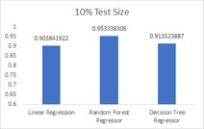
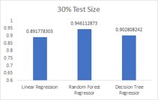

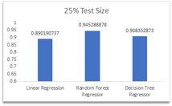
Comparing different models used with different test sizes
Highest Accuracy: Random forest regressor at 10% split

Slide 29
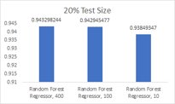
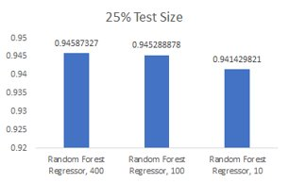
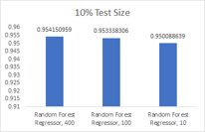
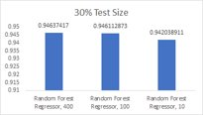
Comparing different no. of estimators used in RFR with different test sizes
Highest Accuracy: RFR with no. of estimators 400 at a 10% split

Slide 30
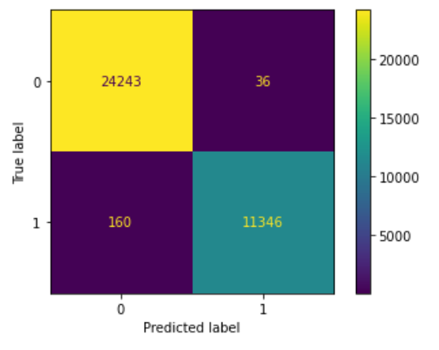
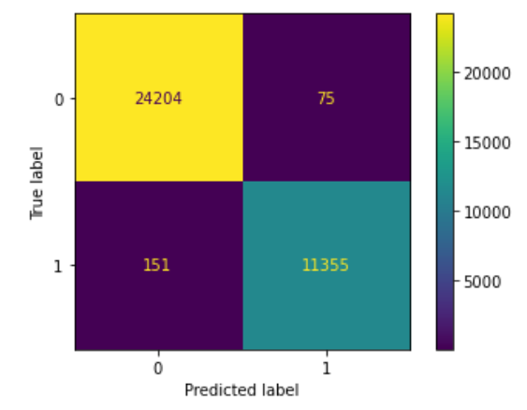
Confusion Matrix
Random Forest Classifier
Accuracy: 99.4%
LightGBM Classifier
Accuracy: 99. 3%

Slide 31
Conclusion
Based on the output of our problem, we selected Random forest regression.
With increase in the no. of estimators the accuracy increased irrespective of our test size.
Currently the 400 is the best no. of estimators to build the most accurate model.
To select the best no. of estimators we can use XGBoost algorithm and perform a grid search to identify the best no. of estimators to achieve the highest possible accuracy.

Slide 32

Thank you! Question?

